Slide 1
Graph Searching
Union-Find Data Structure

Slide 2
Binary relation
Let A be set. A binary relation R on a set A is any subset of A x A, i.e., R is a subset of A x A.
If (x, y) in R we write x R y, i.e., x is R-related to y.
Example: Let A = {2, 3, 4, 6}. Define x R y if and only if x divides y. Then,
R = {(2,2), (2,4), (2,6), (3,3), (3,6), (4,4), (6,6)}

Slide 3
Equivalence relation
A binary relation on a set A is said to be an equivalence relation on A if and only if the following are satisfied
(x, x) in R for each x in A. (reflexive)
if (x, y) in R then (y, x) in R. (symmetric)
if(x, y) and (y, z) in R then (x, z) in R. (transitive)

Slide 4
Example
A = {1, 2, 5, 6, 10, 13} x R y if and only if x % 3 = y % 3
(do on the board)

Slide 5
Equivalence class
Let R be an equivalence relation on A. Let a ∈ A the equivalence class [a] = {x ∈ A | x R a}.
∪ [a] = A [a], where b is a member of [a]
[a] ∩ [b] = φ, otherwise
a ∈ A
10
6
2
1
13
5

Slide 6
Graph example
Let G be a graph with V vertices and E edges. Let R be a binary relation on V defined as follows: (x, y) in R if and only if vertex x and vertex y are in the same connected component of G.
3
1
2 7 8 9
11
6 5 10
12 13
4
[1] = {1, 2, 3, 4, 5, 6, 7} [8] = [9] = {8, 9}
[10] = [11] = [12] = [13] = {10, 11, 12, 13}

Slide 7
How can we find equivalence classes?
Given a set of elements, it is often useful to partition them into a number of separate, non-overlapping sets. A union-find structure keeps track of such a partitioning and performs two useful operations:
Find: Determines which set a particular element is in and is useful for determining if two elements are in the same set.
Union: Combines or merges two disjoint sets into a single set.

Slide 8
Representing sets in general
3
Represent each set using a rooted tree, where each node points to its parent instead of its children.
Furthermore, let the name of the set be the name of the item stored at the root.
To find out which subset we are in or to determine if two items are in the same subset simply travel to the root.
To find the union of two subsets simply make the root of one of the trees point to the other.

Slide 9
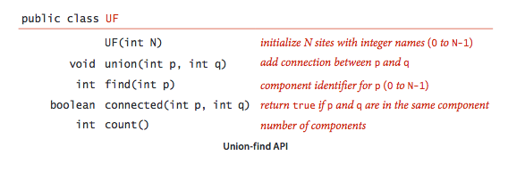
Union Find API

Slide 10
Example
3 subsets
Representation
10
2
6
10
6
1
2
5
1
13
13
5
5 is in the set called 2
1 and 13 are in the same set since they have the same root 10

Slide 11
Example continued
Take the union (1 ∪ 5)
10
6
2
13
1
5
10
6
2
1
13
5

Slide 12
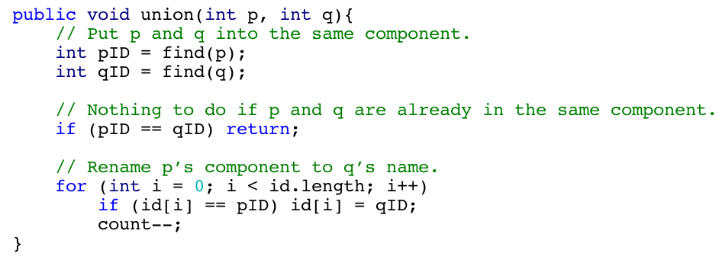

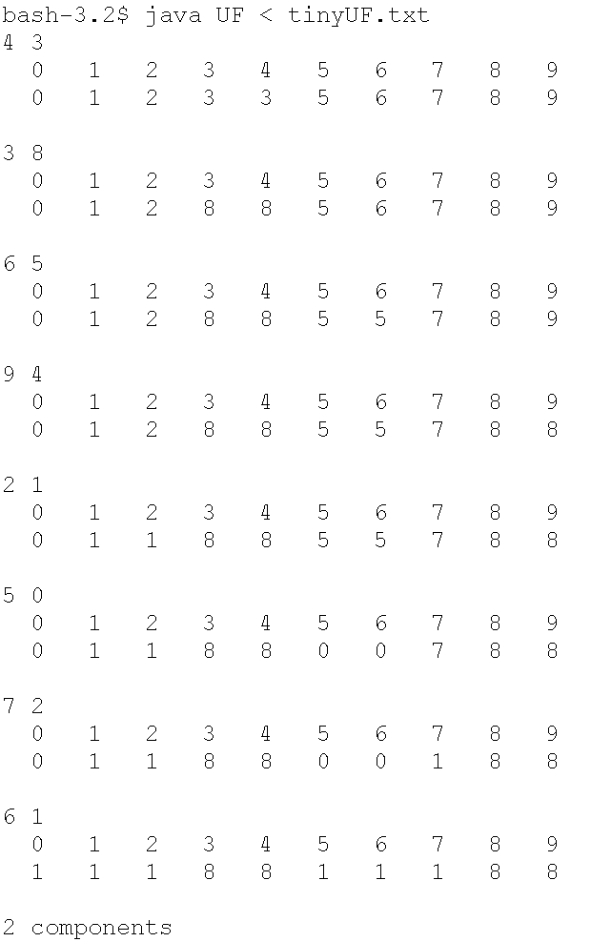
Union-Find (Quick-find)
find()
union()
1
8
5
3
4
9
6
2
7
0
Tree heights are one or two but traverses id[] for each union().
Notes:
Quick-Find
Since find(p) is simply a table-lookup id[p] – constant time
The union(p,q) is unwieldy since the whole array id[] is scanned to change the entries.

Slide 13
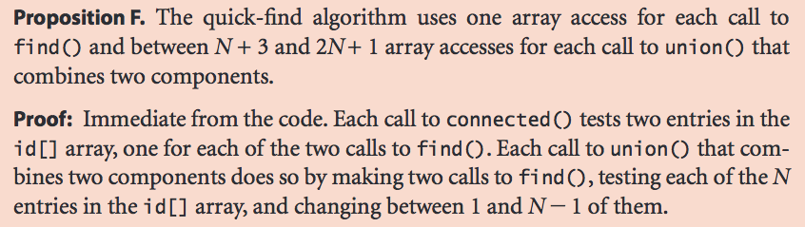
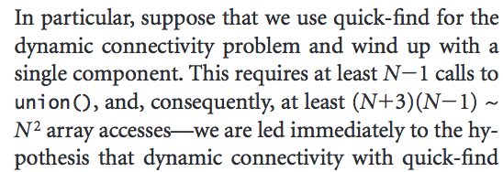

Analysis of Quick-find
Array accesses
Worst-case
0 2
0
1
1 3
4 0
4
2
3 2
3

Slide 14
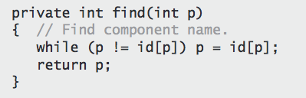
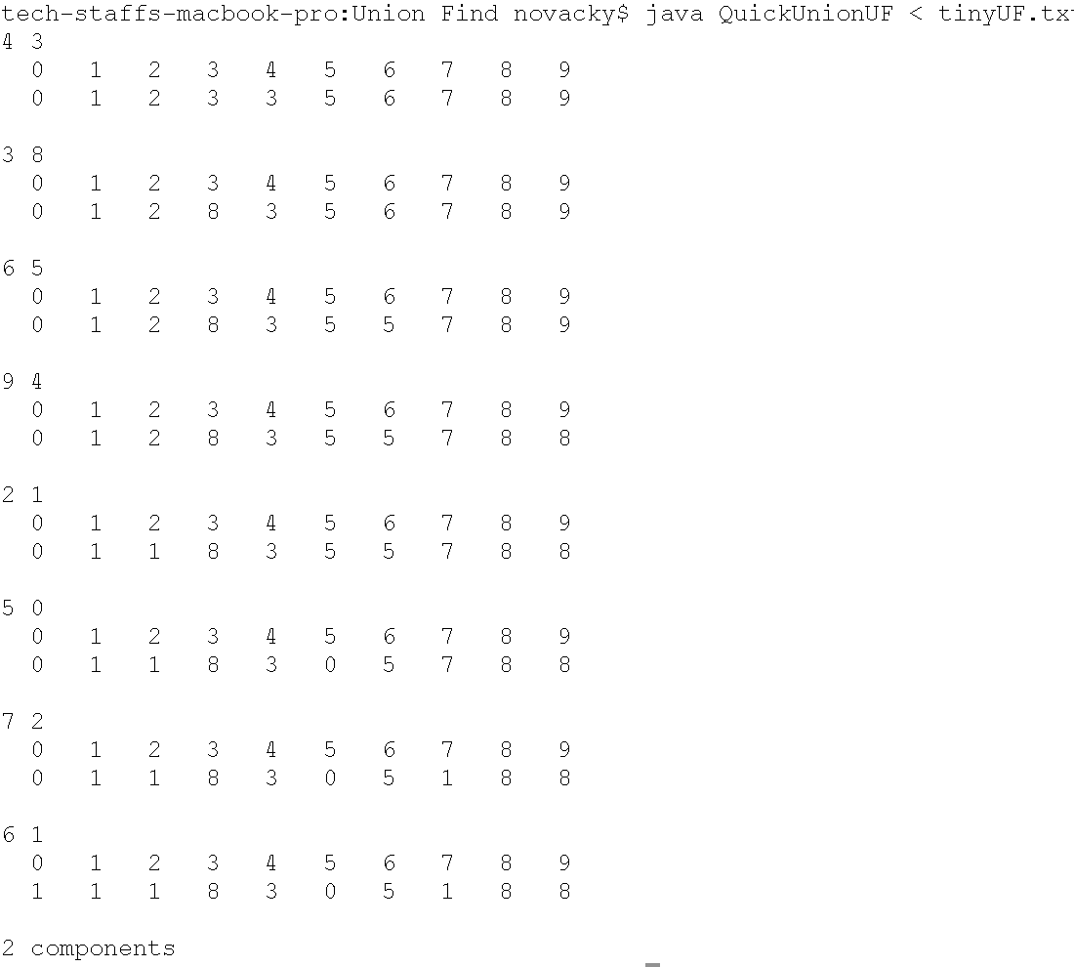
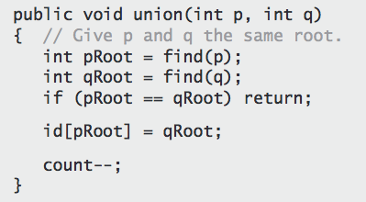
Union-Find (Quick-union)
find()
union()

Slide 15
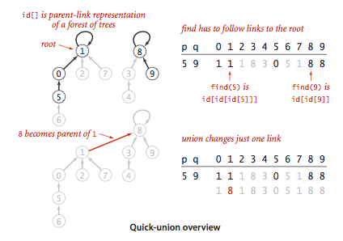
Quick-Union

Slide 16


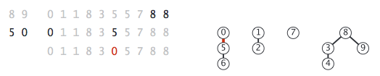


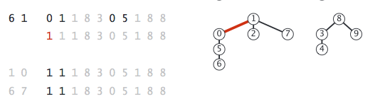


Quick-union (tinyUF.txt)

Slide 17
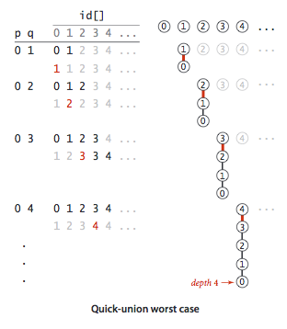
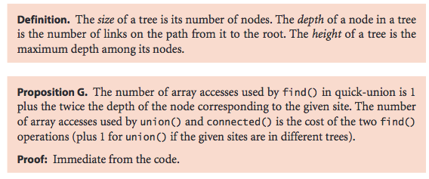
Quick-Union analysis

Slide 18
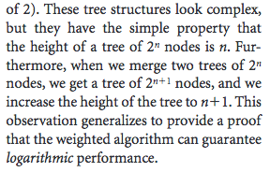
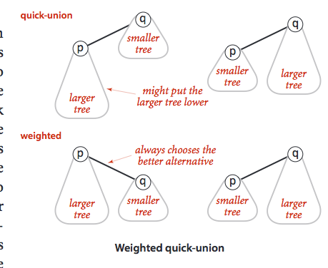
Weighted Quick-Union

Slide 19
Worst-case performance
1
2
3
…
V
1
1
2
3
…
V
2
3
1
4
4
…
V
…
2
V
3
O(V²)union
O(V)find

Slide 20
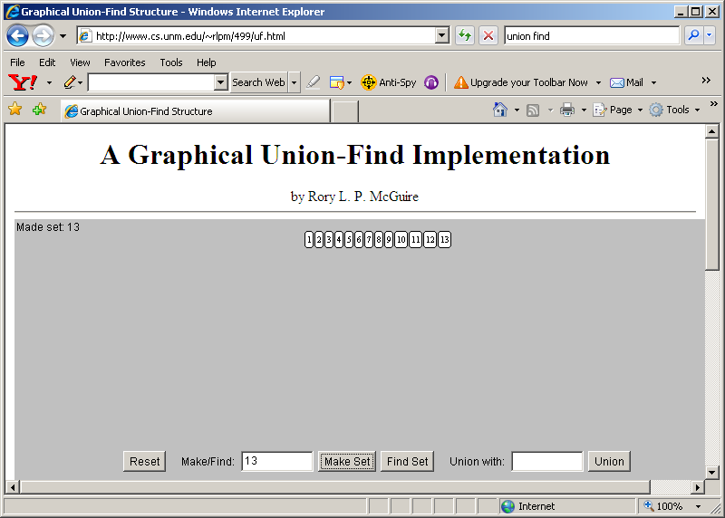












3
1
2 7
6 5
4 8 9 11 10 12 13

Slide 21
Improvements
The idea is to keep these structures as squat as possible!
Weight-balancing - make the root the node with more descendants (minimize distance to root for most nodes)
Path compression - make each node we come across point directly to its root

Slide 22
Path compression
Code
Example
i = find(x)
while(id[x] != x){
t = x;
x = id[x];
id[t] = i;
}
i
i
x
t
x
t
x

Slide 23
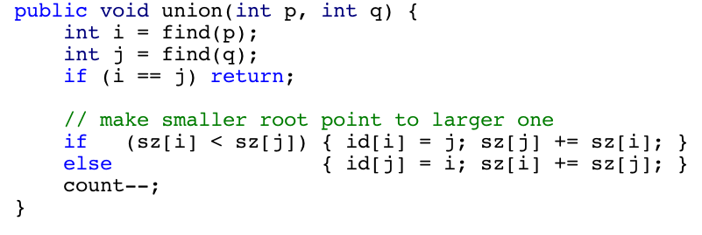
Weight balancing
union(A,E)
A
Code
sz4
E
sz3
B
C
G
D
F
A B C D E F G 1 2 3 4 5 6 7
1 1 1 5 5 5 1
A
sz7
id[]
X
1
E
G
B
C
D
F

Slide 24
Analysis
Worst-case analysis is difficult in this problem since the analysis depends on the number of find operations and on the order in which the union and find operations appear.
We do know if weight balancing and path compression are used to build a graph with |E| edges then the run-time is very nearly linear.

Slide 25
Application
Determines whether a graph on |V| vertices and |E| edges is connected in space proportional to |V| and runs in almost linear time with respect to |V|.
This is an improvement over depth-first search since we don’t have to store the edges.

